Slide 2
Designing for multiple devices – An introduction
duration: 45 mins
session by:

Slide 3
Designing for multiple devices
Gain an understanding on ecosystem of connected devices
Know the framework of designing for multiple devices
Understand the key considerations for cross-platform devices
Apply the learnings on a quick activity
At the
end of
this session:
Notes:
For example, the shopping feature on an iWatch may not make much sense, but subsets can be translated on the watch like status, tracking order and notifications.
Identifying scenarios in which a product will be used across various device groups.
People constantly shift back and forth between devices to get things done, and they expect their products and services to shift with them. Users do not have to think about the device, changes in the environment, or changes in context.

Slide 4
Introduction
Designing for multiple devices
How to design a product for people who own multiple devices and use them interchangeably?
In this system—this climate of multiple devices—we see smartphones, tablets, laptops, TVs and other connected devices all interacting with one another and wirelessly sharing data.
Notes:
For example, the shopping feature on an iWatch may not make much sense, but subsets can be translated on the watch like status, tracking order and notifications.
Identifying scenarios in which a product will be used across various device groups.
People constantly shift back and forth between devices to get things done, and they expect their products and services to shift with them. Users do not have to think about the device, changes in the environment, or changes in context.

Slide 5
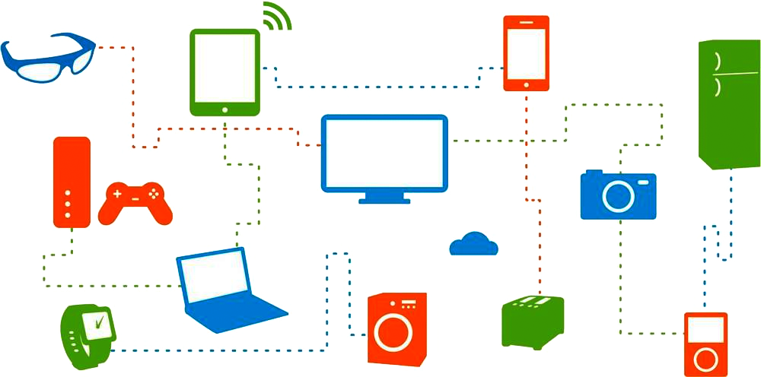
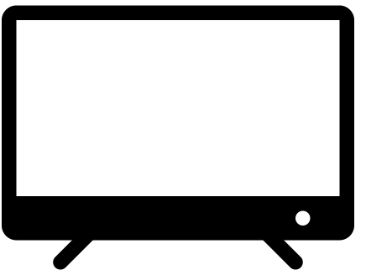
An ecosystem of connected devices
Designing for multiple devices
It is important to understand the different relationships between connected devices, as well as how individuals relate to them, to create natural, fluid multi-device experiences that allow these dynamic changes.
These experiences should focus on how the (increasing) set of connected devices can best serve users’ needs as they move between activities and contexts throughout the day.
An ecosystem of connected devices, including those that are already available today and a few upcoming ones
Source: oreilly.com
Notes:
These devices have differences in facets like form factor, screen size, interaction model (touch, keys, voice), and sensors (GPS, accelerometer, gyroscope, and others).
You can control over 50,000 smart home devices including TVs, lights, appliances, plugs, thermostats, and more when you add them to the Google Home app.
HomeKit isn't a product or software; it's a framework that links smart home products together and adds new capabilities to devices like lights, locks, cameras, thermostats, plugs, and more. HomeKit lets you control smart home products using apps on your iPhone, iPad, or Mac, or simple Siri voice commands.

Slide 6
The 3Cs framework: Consistent, continuous and complementary
duration: 45 mins
session by:

Slide 7
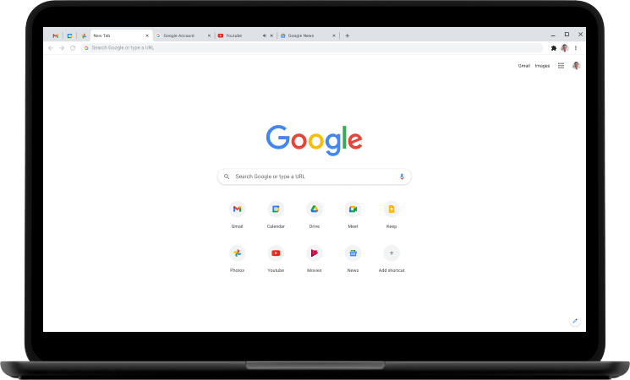
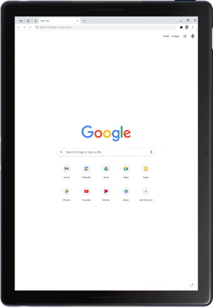
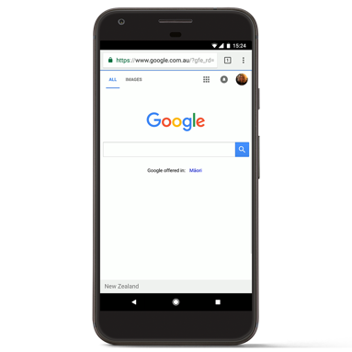
Consistency
Designing for multiple devices
The consistent approach: the same content offering is replicated across devices, with some adjustments to accommodate each device’s characteristics.
Consistency is applied in:
Consistent core functionality across devices
Consistent IA across devices
Consistent look and feel across devices
Source: oreilly.com
The Google Search app provides the same search experience across all devices.
Notes:
Consistent core functionality across devices
The vital components of the experience should be kept consistent across devices.
Consistent IA across devices
The basic information structure, organization and terminology should be kept consistent across devices
Consistent look and feel across devices
A common visual language should be used across devices to help people establish not only the brand personality, but also the cognitive and affective tie between devices.

Slide 8
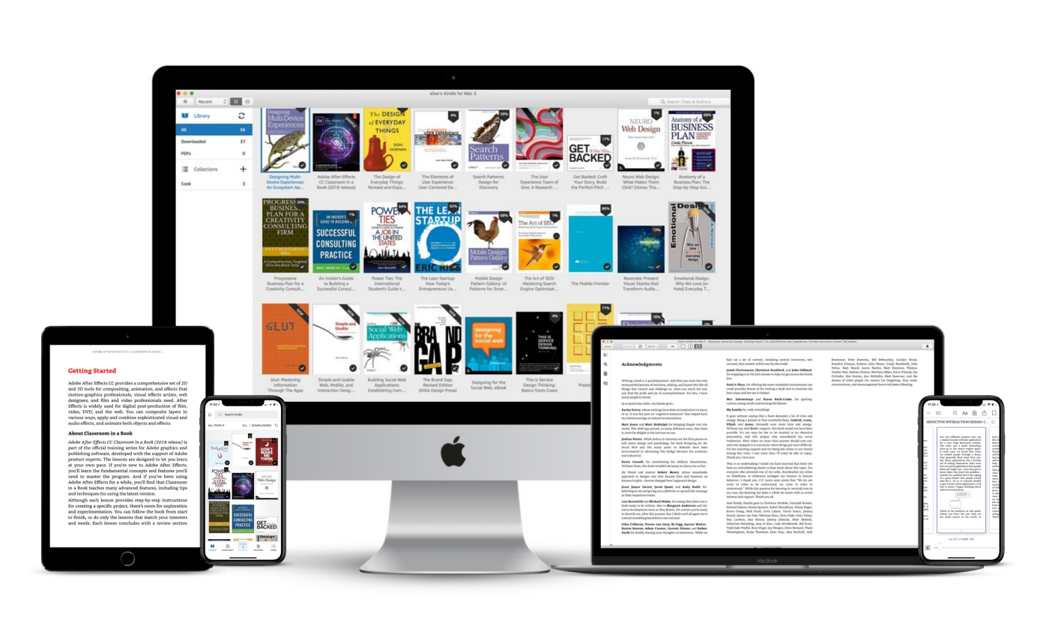
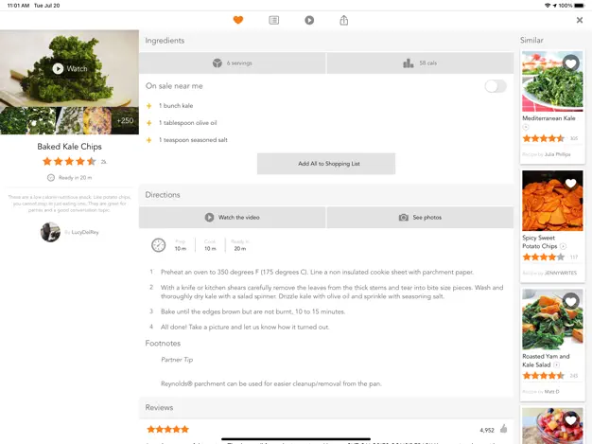
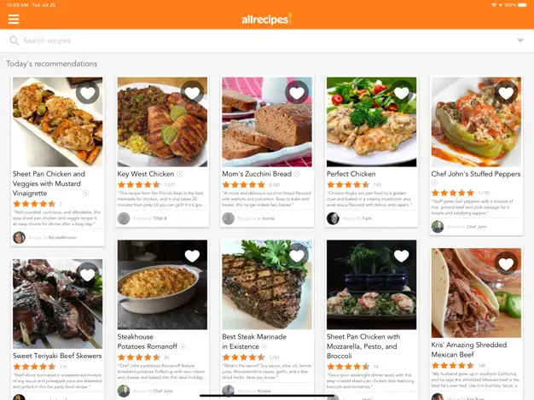
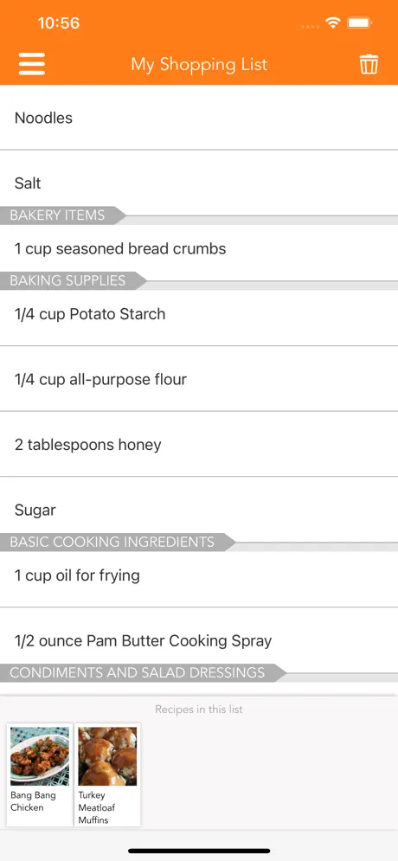
Continuity
Designing for multiple devices
A continuous approach provides an end-to-end user experience that is distributed across multiple devices. With this “passing of the baton” approach, each device picks up where the previous one left off.
The two chief experience types that continuous design addresses:
Single activity flow: A single activity—reading a book or watching a movie—typically requires a significant period of time to complete.
Sequenced activities flow: Some task flows need users to complete a sequence of activities to reach the end goal.
Reading is a “continuous activity”. Synchronization helps achieve seamless user experience on Kindle across devices.
Source: oreilly.com
Source: Appstore
Allrecipes apps
Notes:
Allrecipes apps for iPad (Your Kitchen Inspiration) and iPhone (Dinner Spinner), demonstrating a continuous cooking flow made up of sequential activities taking place on different devices: (1) looking for recipes, (2) getting the groceries, and (3) cooking.
Sequenced activities flow
Some task flows need users to complete a sequence of activities to reach the end goal. Each step is typically done in a different location, at a different time, with different devices being available and/or most convenient for each activity.

Slide 9
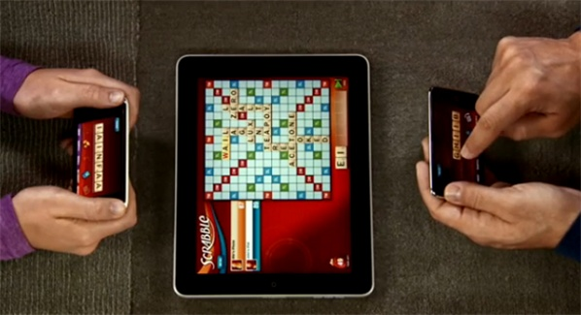
Complementary
Designing for multiple devices
With the complementary approach, the different devices work together as a group, complementing one another to create the full experience.
Complementary approach involves two types of device relationships:
Collaboration: Different devices, each with their own distinct role, work together collaboratively (and usually simultaneously) to construct the whole experience
Control: The user’s primary experience takes place with a particular device, while other devices control aspects of that experience, usually remotely (e.g., a smartphone that serves as a remote control for a television).
Playing Scrabble with the tablet as a game board and smartphones holding the tiles.
Source: https://scrabble.wonderhowto.com/

Slide 10
Consideration for cross-platform devices
duration: 45 mins
session by:

Slide 11
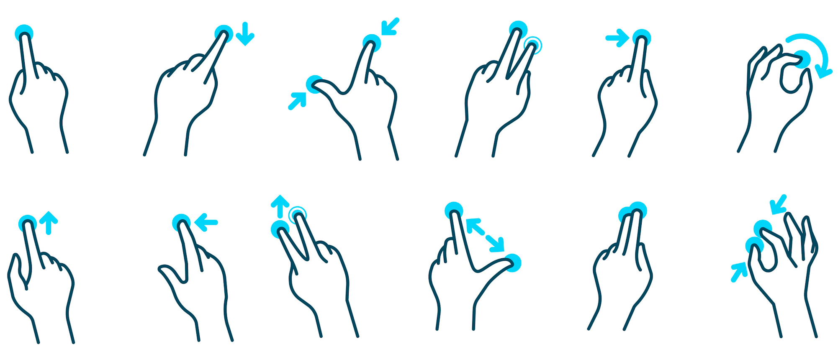
Gestures
Designing for multiple devices
It’s important to consider making use of various device functionalities when designing digital products. Mobile devices have the ability to take advantage of functionality like GPS, biometric ID, bank card scanning and QR code reading that can greatly improve the UX.
Mobile devices, tablets and smart watches allow users to interact with screen elements using touch. The ability to pinch, zoom, slide images across the screen, and force-touch elements empower the user to engage with the content in a new way.
Source: xd.adobe.com
Notes:
For example, A long repeating row of the content may look great on a desktop computer, but for a mobile device, it may make more sense to allow the user to slide through the carousel one by one.

Slide 12
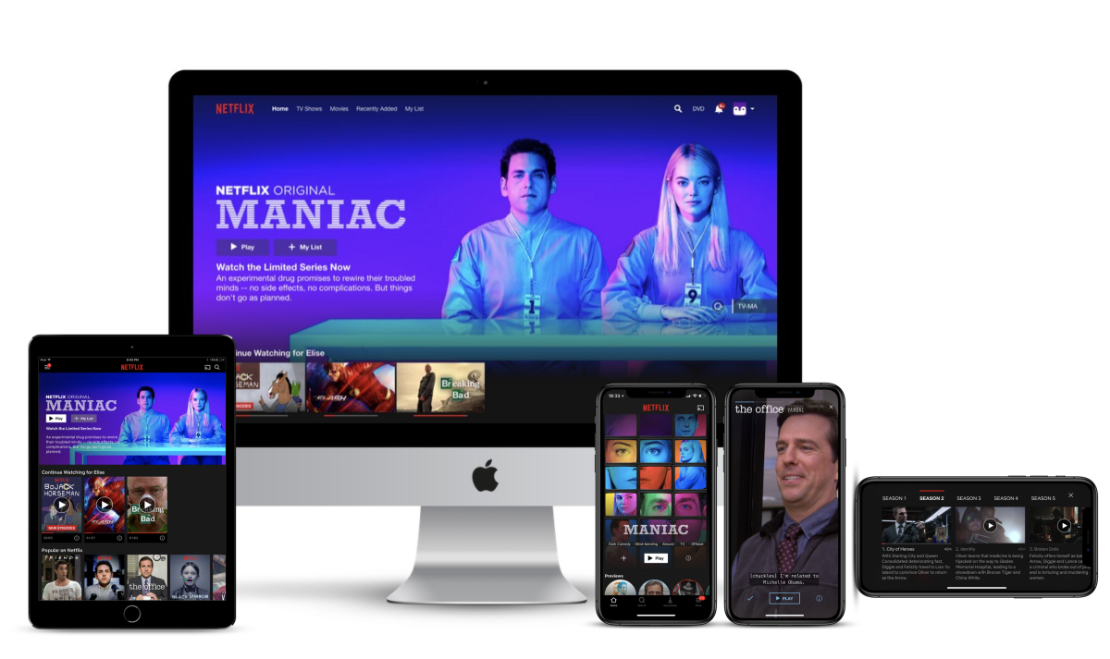
Hierarchy
Designing for multiple devices
When designing for different devices, you should always be mindful of the layout hierarchy and ensure that key messages maintain the same prominence across devices.
Ask what the most important action of the page is. If the call to action of a page is a sign-up button, make sure that this maintains its prominence across all devices.
Source: https://medium.com/

Slide 13
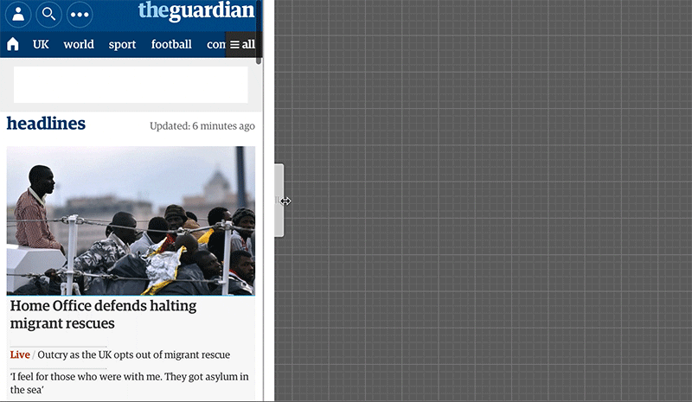
Designing for multiple devices
Navigation pattern
When designing navigation across devices, it is important to follow conventions for the device in question. Consistency is important to ensure that users don’t feel challenged trying to learn a new navigation paradigm.
Use clear, useful and familiar copy for your navigation elements to make users comfortable engaging with your website on different platforms.
By using appropriate and familiar copy for your navigation elements, your users will feel more comfortable engaging with your website on different platforms. When consistency is maintained and clarity promoted, it makes the navigation easier to comprehend.
Source: bradfrost
Notes:
Whether it’s in the form of a breadcrumb menu, a dropdown or tabs, every product needs to have a user flow that a person can navigate to achieve their goals.

Slide 14
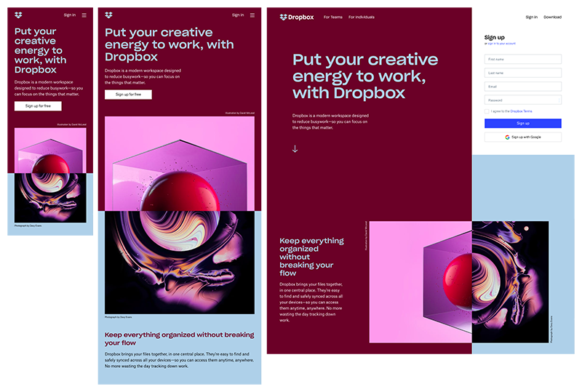
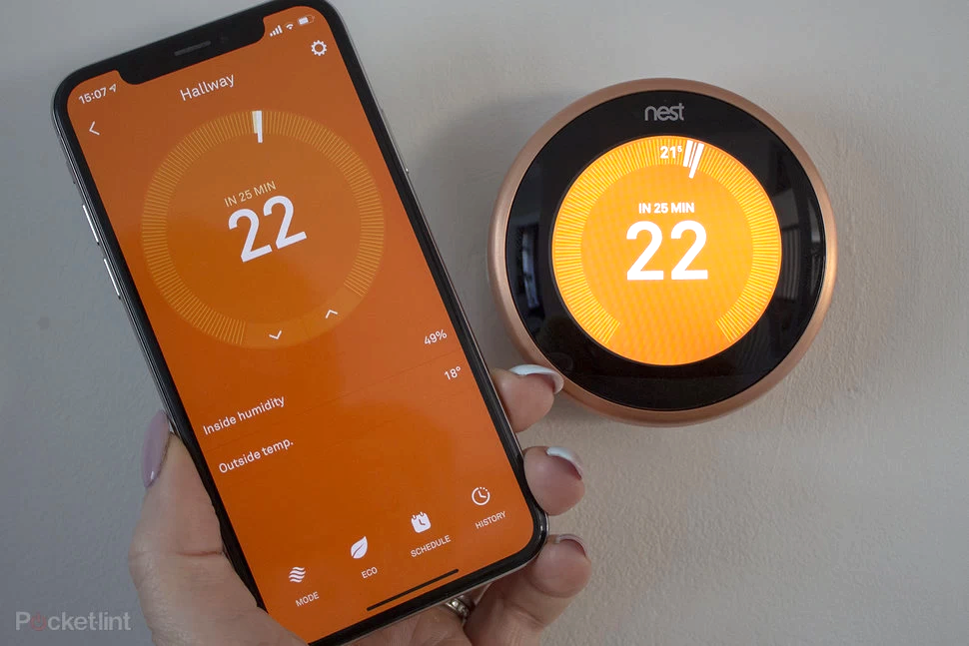
Layout: Responsive design / Adaptive design
Designing for multiple devices
Adaptive design ensures the best user experience according to the device the user is using to interface.
Responsive is fluid and adapts to the size of the screen no matter what the target device.
Source: Invisionapp
Source: POCKET-LINT
Notes:
Dropbox has done a great job of using a fluid grid and flexible visuals to design a standout responsive website. Not only does the font color change to accommodate the background color when shifting from desktop to handheld devices, but the image changes orientation as well.
Accounting for context, Dropbox offers a tailored experience across each device. For example, to prevent users from bouncing, a small arrow directs desktop users to scroll down to see more content. The same arrow is absent from handheld devices, since it’s assumed that users will naturally scroll on a device with touchscreen capabilities. Similarly, their signup form is visible on desktop devices, but it’s hidden behind a call-to-action button on tablets and mobile devices, where space is limited.

Slide 15
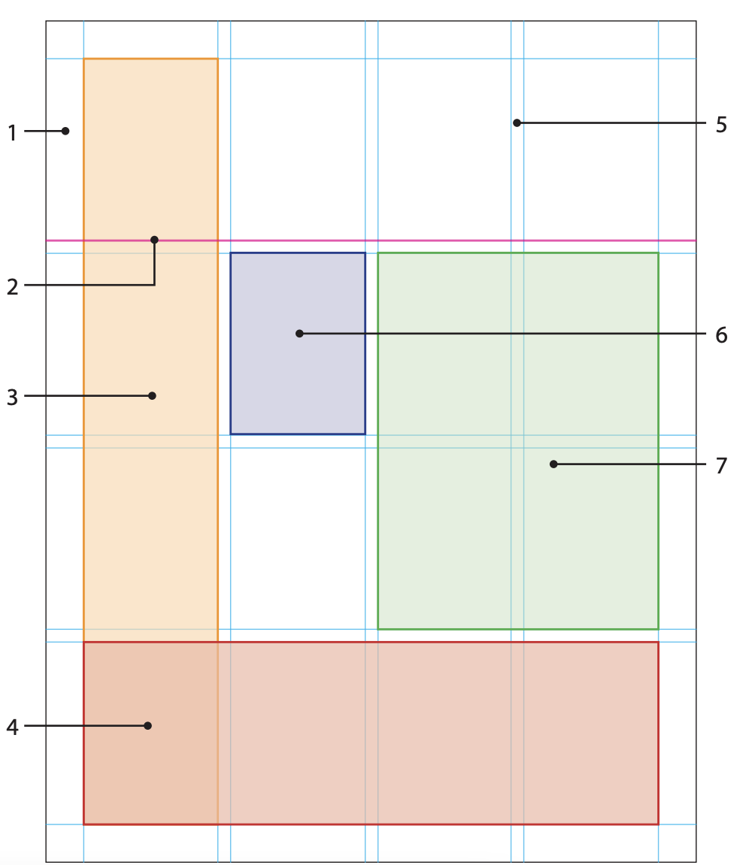
Grids
Designing for multiple devices
The website grid is a system for organizing the content on the page and creating alignment and order. These guidelines incorporate margins, spaces, and columns, collectively – providing an encompassing, consistent framework for the page’s content. Grids anatomy consists of:
MARGIN: The space that separates the content from the edge of the page.
FLOWLINES: Divides the page into horizontal intervals creating additional alignment points.
COLUMNS: Vertical divisions of space used to align the visual elements.
ROWS: A series of flowlines creating horizontal divisions of space.
GUTTERS: Negative inactive space that separates rows and columns.
MODULES: Individual units of space created from intersecting rows and columns.
SPATIAL ZONES: Groups of modules that cross multiple rows and columns.
Source: Imagestation.com

Slide 16
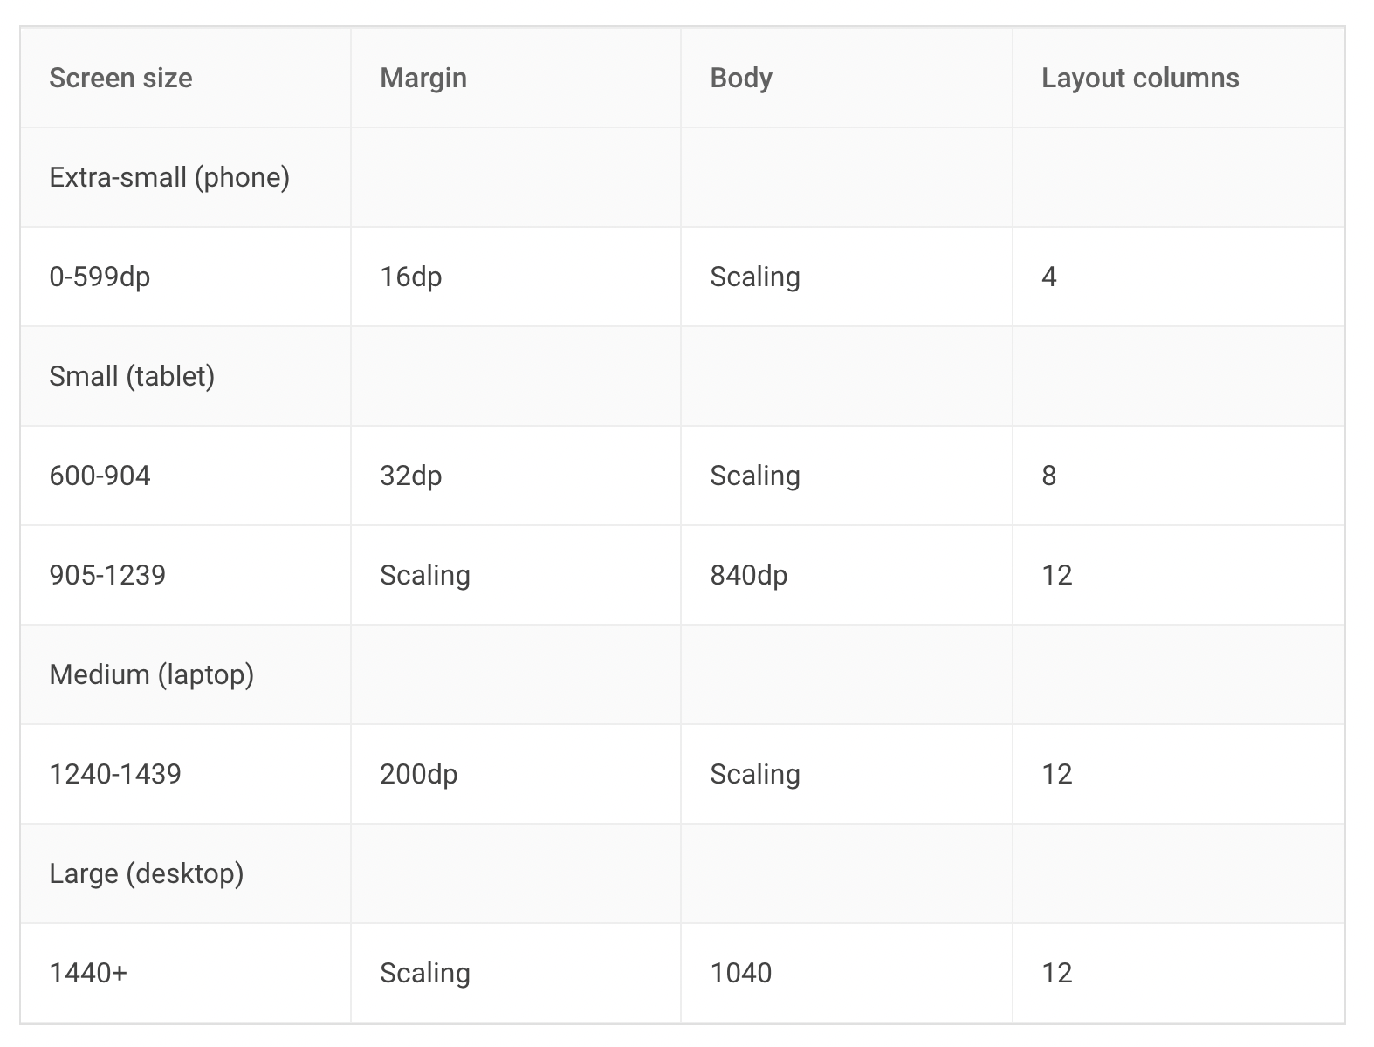
Grids - in context of responsive design
Designing for multiple devices
The layout grid can be adjusted in terms of its column, gutter & margin to meet the needs of both your product and multiple device sizes.
Breakpoints
A breakpoint is the screen size threshold determined by specific layout requirements. At a given breakpoint range, the layout adjusts to suit the screen size and orientation.
Each breakpoint range determines the number of columns, and recommended margins and gutters for each display size.
Breakpoint system
When scaling a layout for different screen sizes or orientations, the responsive grid adjusts margin and body widths as well as the number of columns in the layout.
Material design uses 4-column, 8-column and 12-column grids
Notes:
Breakpoints to include portrait/ orientation

Slide 17
Activity
duration: 45 mins
session by:

Slide 18
Match the following
Designing for multiple devices
Continuous
Netflix provides experiences across devices and optimizes for each of them.
Consistent
Instagram created a community for users to create, share and comment on content. The desktop version is mainly for browsing than posting, indicating a “mobile-first strategy”
Complementary
The display of information or content is shifted to a separate device by the user, like in Microsoft Teams.
Contextual
Combining other physical channels to create a new experience with hybrid media and devices, to complete a single goal
Notes:
Continous - The display of information or content is shifted to a separate device by the user, like Microsoft teams.
Consistent - Netflix provides experiences among devices and optimizes for each of them.
Complementary - Combining other physical channels to create a new experience with Hybrid media and devices to complete a single goal
Contextual - Instagram created a community for users to create, share and comment on content, Desktop version is mainly for browsing than posting, indicating “mobile-first strategy”

Slide 19
Quiz
Designing for multiple devices
Pick three essential questions that give directional input when designing for a multi-screen experience.
A
B
What is the purpose of your website? This helps define what information is essential and what information can be eliminated to provide quick access to crucial details.
What will visitors do on your website? This helps define what functionality is vital and how to make it easily accessible on each screen size.
C
D
What is the goal of the business leaders and investors for the product and the metrics of success?​
What devices do your target market use most of the time? This helps to focus on the most viewed version and provides the best user experience for customers. ​
Notes:
A, b and d are correct.

Slide 20
Designing for multiple devices
Reading is always a “continuous” activity. In the digital world, people may use different devices to read. OR find something to read first, and then read it. Thanks to —————————— it’s very easy to jump from one device to another while reading the same book because it saves your progress.
A
B
Optimisation
Coherence
C
D
Synchronisation
Collaboration
Notes:
C) Synchronization

Slide 21
Designing for multiple devices
Discovering (music) works better on the desktop because larger screens can contain more information. Its mobile app is also equipped with voice control for users to search for songs. Try saying “play something special”, and you may get a song that surprises and delights you. Pick 3 Cs covered in this case:
A
B
Consistency
Continuity
C
D
Complementary
Congruency
Notes:
A, b and C are correct

Slide 22
Designing for multiple devices
How can layout fit well in different screen sizes? What key components adhere to Responsive Design on different devices? Choose the right answer:
A
B
SVG and vectors
Breakpoints
C
D
Nested elements
Static units
E
All of the above
Notes:
1, 2, and 3 are correct.

Slide 23
Rapid fire round
Designing for multiple devices
1
It adjusts its content and width according to the device
Responsive/Adaptive
2
According to the device, it loads the content of the already-designed web page
Responsive/Adaptive
3
Design snaps into place since the website is serving something different, basis the device or browser used to view it
Responsive/Adaptive
4
Design works well for larger sites that are being built from scratch
Responsive/Adaptive
Notes:
Responsive
Adaptive
Adaptive
Responsive

Slide 24
Resources
Designing for multiple devices
https://xd.adobe.com/ideas/process/ui-design/adaptive-design-vs-responsive-design/
https://learning.oreilly.com/library/view/designing-multi-device-experiences/9781449340391/ch02.html

